Slide 1
ECF SHARED LIBRARY
ECF Next and ecf content access usage with ecf shared library

Slide 2
Agenda
UI Flow for ECF Content Access
Testing
Testing ECF Shared in ECF Next – NPM PACK
Testing ECF Shared in ECF Content Access – NPM PACK
Debugging ECF Shared Library
Dealing with environments in ECF Shared Library
ECF Shared Library Module
Updating README markdown file
Deploying ECF Shared to NPM as a Private Package
Design Considerations
Questions/Answers

Slide 3
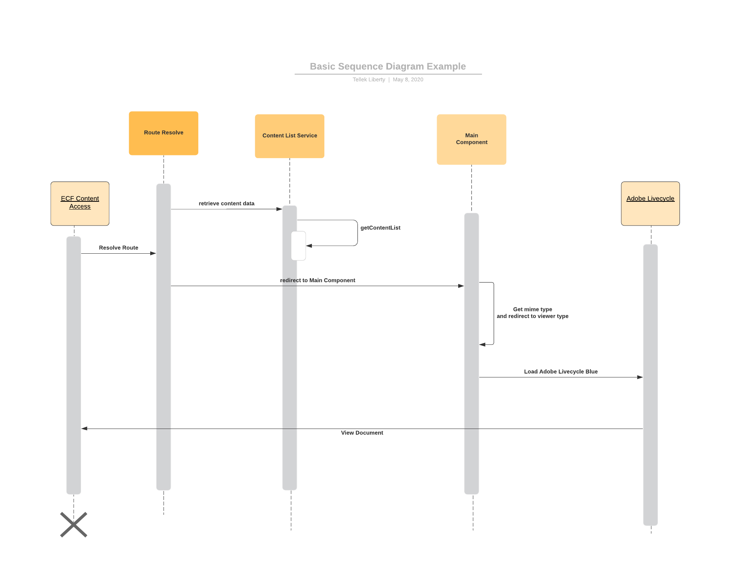
UI Flow for ECF Content Access

Slide 4
Testing
DEMO
Testing ECF Shared in ECF Next – NPM PACK
Testing ECF Shared in ECF Content Access – NPM PACK
Debugging ECF Shared Library
Dealing with environments in ECF Shared Library
ECF Shared Library Module

Slide 5
Updating README.md with your changes
What to put in the README markdown file
All documentation explaining Services, components, directives, pipes, .etc that will be used or exposed to ECF Next and ECF Content Access
Could include screenshot, if possible
Sample coding, where necessary
DEMO of README.md Contents
https://www.npmjs.com/package/@hennepin-mn-us/ecf-next-shared/v/5.0.13

Slide 6
Deploying ECF Shared to NPM as a Private Package
npm run publish-library-prod – will published the private package
npm login && npm publish --access restricted
Make changes to Azure DevOps to recognize Private Package
Working on This!!
Will send email out

Slide 7
Design Considerations
ECF Next and ECF Content Access Architecture
Sub Projects VS Angular Applications – Benefits and Disadvantages
View Models For ECF Next and ECF Content Access
Content List Drawer design Preparation
“Function Not Yet Developed!” Component could be a good recommendation for ECF Shared
Handling CSS Styles (Allow customization between ECF Next and ECF Content Access)
Routing vs Events (dealing with pitfalls when using routing between applications)

Slide 8

Questions and Answers

